Slide 1
Log-linear analysis

Slide 2
Analysis of count data
Introduction to log-linear models

Slide 3
The Poisson probability model
Let N be a random variable representing the number of events during a unit interval and let n be a realisation of n (COUNT): N is a Poisson r.v. following a Poisson distribution with parameter λ:
The parameter λ is the expected number of events per unit time interval: λ = E[N]

Slide 4
Likelihood function
Probability mass function:
Log-likelihood function:
⇒ Likelihood equations to determine ‘best’ value of λ

Slide 5
The log-linear model
The objective of log-linear analysis is to determine if the distribution of counts among the cells of a table can be explained by a simpler, underlying structure.
Log-linear models specify different structures in terms of the cross-classified variables (rows, columns and layers of the table).

Slide 6
Log-linear models for two-way tables
Saturated log-linear model:
Overall effect (level)
Main effects
(marginal freq.)
Interaction effect
In case of 2 x 2 table:
4 observations
9 parameters
Normalisation constraints

Slide 7
Relation log-linear model and Poisson regression model
are dummy variables (0 if i or j is equal to 1and1 if i or j equal to 2) and interaction variable is

Slide 8
Design matrix unsaturated log-linear model
⇒
Number of parameters exceeds number of equations ⇒ need for additional equations
(X’X)⁻¹ is singular ⇒ identify linear dependencies

Slide 9
The log-rate model Statistical analysis of occurrence-exposure rates

Slide 10
The log-rate model: the occurrence matrix and the exposure matrix
Occurrences: Number leaving home by age and sex, 1961 birth cohort: n_{ij}
Exposures: number of months living at home (includes censored observations): PM_{ij}

Slide 11
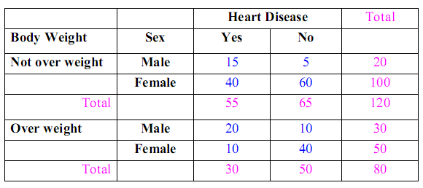
Ejemplo:
Suppose we are interested in the relationship between sex, heart disease and body weight. We could take a sample of 200 subjects and determine the sex, approximate body weight, and who does and does not have heart disease
The contingency table :

